Slide 1
Capstone 1: big mountain resort
Rayees ahamed b
Springboard - data science career track

Slide 2
Background Information
Big Mountain Resort – ski resort company, installed additional chair lift to increase distribution of visitors that increased the operational costs by $1,540,000.
Company in plan to charge a premium in the ticket prices
Looking to build a strategy that will either cut some operating costs to adjust with the market average price or
To find a better value to justify the price increase.

Slide 3
PROBLEM: How to select a better pricing strategy to support higher ticket price?
What is the problem?
Increased operating cost on the company led to change its pricing model.
Who has this problem?
Big Mountain Resort – ski resort in the state of Montana, USA
Why should this problem be solved?
To accommodate the higher operating costs – a better pricing strategy should be devised
How will I know this problem has been solved?
Finding value added properties of Big Mountain Resort that justifies the price increase.

Slide 4
Workable Solutions
Solution #1
Finding the right values
Solution #2
Cutting the operational costs
Looking for areas to cut operational costs that may help to undermine the ticket price increase
Identifying the key properties that stand out Big Mountain Resort among others to sustain the increased price.

Slide 5
KEY FINDINGS & recommendations
The current price of the Big Mountain Resort is $81, which is moderate price compared to all other resorts in the US.
But it is also the highest in the Montana State.
Our pricing model predicted price change of $91 with the expected error of $10 to support the increased operating costs.
Our model listed below recommendations to justify the price change.
Reducing the total runs up to 10 runs
Increasing the vertical drop by 150 feet with an additional chair lift
Along with that increasing snow cover by 2 acres
Increasing the longest run by 0.2 mile and increasing the snow coverage by 4 acres
The additional operating cost of $1,54,0000 with average sales of 5 tickets per person. It will cost only $0.88 extra per ticket. So, likely this operating cost will be covered by the price increase.

Slide 6
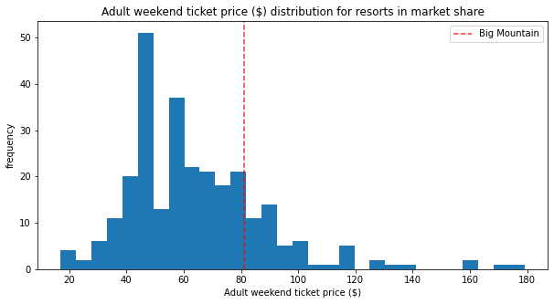
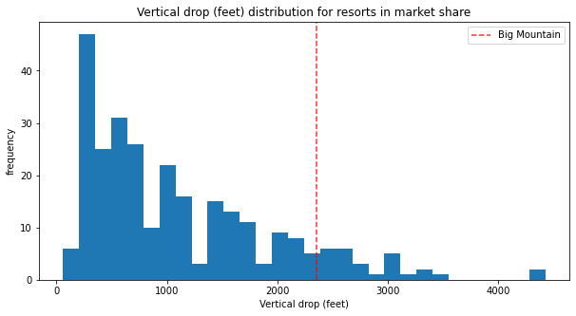
MODELING RESULTS & ANALYSIS
TICKET PRICE
Big Mountain Resort ticket prices were not on the higher side, but moderate when compared with most of the resorts.
So, strong justification required to explain the increased price change.
VERTICAL DROP
Exploring various features, vertical drop is not quite high with Big Mountain, where some resorts offer even higher drop.
Increasing the vertical drop one viable option that company can explore.

Slide 7
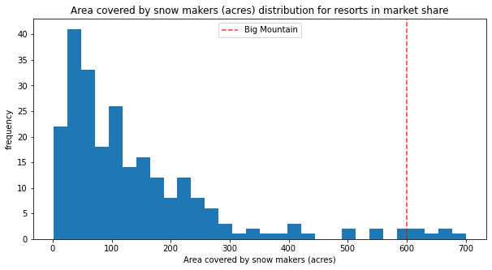
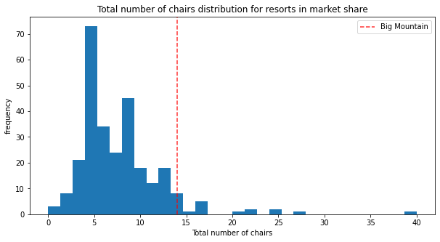
MODELING RESULTS & ANALYSIS
SNOW MAKING AREA
Big Mountain Resort has highest snow making area which outstands other resorts.
Adding 2 more acres of snow making will increase the support for price change.
TOTAL NUMBER OF CHAIRS
Also, the Big Mountain Resort has highest number chair lifts compared with other resorts.
Installing additional chair lifts will stand out among the resorts – hence supporting price change.

Slide 8
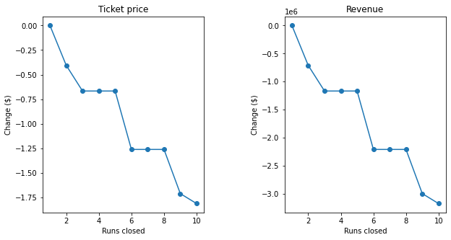
MODELING RESULTS & ANALYSIS
CLOSING TOTAL RUNS
There is strong association between closing runs and ticketing price change
Closing 3 or more runs significantly supports price change up to 10 runs closure.

Slide 9
SUMMARY & CONCLUSION
The data analyzed had limited information on operating costs – so we decided to find right values within the Big Mountain resort to support the price change.
Based on the modelling and analysis, we found certain facilities were unique to our resort – provides significant advantage to justify the increased price.
The expected pricing from model suggests $91 which is below than the current price of $81.
Following the model recommendations such as installing additional chair lift will increase the chance of price support – also these additional operating costs will cover only $0.88 per ticket with average sales of 5 tickets per person.
Hence, likely the predicted price from our model will cover the operating costs undermined.

